Slide 1
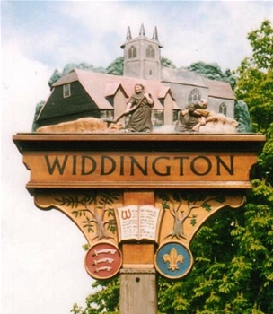

Widdington Parish Council
Widdington Annual Parish Meeting
Chair’s Report 2021

Slide 2
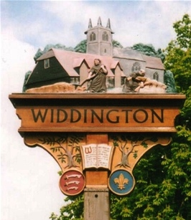
Following the recent elections your WPC consists of 5 members & the clerk
Clerk to WPC
Amanda Lindsell
Elected as parish councilors without a contest
Jill Brookman
Chris Firmin
Maria Orr
Ian Southcott
Maggs Webb
2 vacancies for parish councillors open

Slide 3
On behalf of WPC and the village we would like to thank outgoing councillors
Margaret Hudson
Thank You

Slide 4

COVID-19 has impacted the way WPC have operated during 2020/2021
WPC move to virtual meetings adopted during 2020/2021 including facilities for public participation via ZOOM
Return to face-to-face meetings planned for June 2021 onwards

Slide 5
WPC Planning Update

Slide 6
Planning issues continue to be a major activity for WPC
Uttlesford Local Plan withdrawn 2020. New plan in progress
  Local Plan will set out how and where new homes, jobs, services & infrastructure will be delivered and the type of places and environment that will be created
In accordance with the outputs of the Village Design Statement questionnaire WPC have reviewed 36 planning applications and actively objected to 13 in May 2020 – May 2021
Expenditure for fighting key planning applications (01/04/20 – 31/03/21) is £10,650 (42.6% annual precept; 37.2% WPC total annual expenditure)

Slide 7
Widdington Play Park

Slide 8
Widdington playpark renovated; favourable ROSPA report issued
Significant effort by residents undertaken to ensure safety and future of playpark
  New swings installed
  Old, deteriorated play equipment removed
Royal Society for the Prevention of Accidents (ROSPA) inspection conducted in 2020; no significant maintenance issues identified

Slide 9
Widdington Emergency Plan

Slide 10
Widdington Emergency Plan updated and adopted June 2020
The Widdington Emergency Plan was revised during 1H2020. Reviewed and adopted June 2020
Emergency plan in operation during pandemic ensuring support for key villagers

Slide 11
Widdington Parish Council
Questions

